Slide 1
Cervical cancer risk prediction and identification of risk factors.

Slide 2
Overview:
Worldwide, cervical cancer is both the fourth-most common cause of cancer and the fourth-most common cause of death from cancer in women. In 2012, an estimated 528,000 cases of cervical cancer occurred, with 266,000 deaths.This is about 8% of the total cases and total deaths from cancer. About 70% of cervical cancers occur in developing countries.

Slide 3
Problem statement:
Despite the possibility of prevention with regular cytological screening, cervical cancer remains a significant cause of mortality in low-income countries. As in many other diseases, there are several screening and diagnosis methods. In the detection of precancerous cervical lesions, screening strategies include cytology, colposcopy and biopsy. In developing countries resources are very limited and patients usually have poor adherence to routine screening due to low problem awareness. Consequently, the prediction of the individual patient’s risk and the best screening strategy during her diagnosis becomes a fundamental problem. Most of these screening methods highly depend on the physician expertise and subjective comfort on the decision process, being a key aspect to improve data acquisition using the physician preferences. Identification of key risk factors would improve the collection of necessary patient data and, on their basis, determine whether the patient needs an additional examination.

Slide 4
Project objective and Data Source:
This project will examine data collected at 'Hospital Universitario de Caracas' in Caracas, Venezuela.
http://archive.ics.uci.edu/ml/datasets/Cervical+cancer+%28Risk+Factors%29
The dataset was obtained from UCI repository and comprises demographic information, habits, and historic medical records of 858 patients, each record with 35 features. Several patients decided not to answer some of the questions because of privacy concerns.
The aim of this project is identification of risk factors for cervical cancer through statistical analysis, visualization methods and predictive modeling.

Slide 5
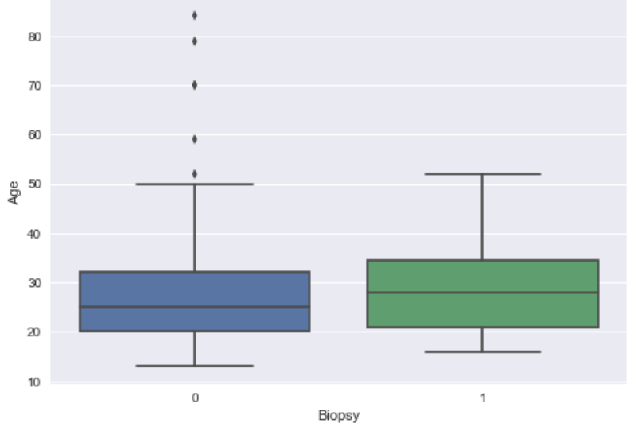
Plots and visualizations
As we can see from the plot the age of most patients with positive biopsy test is from 21 to 35 years old.

Slide 6
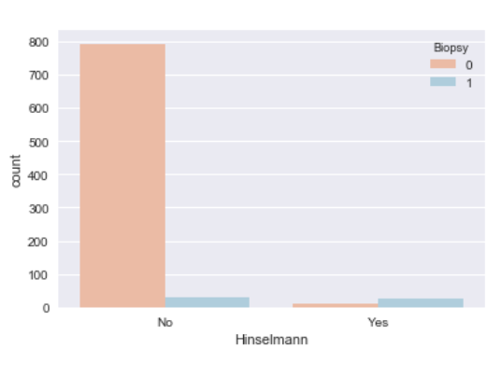
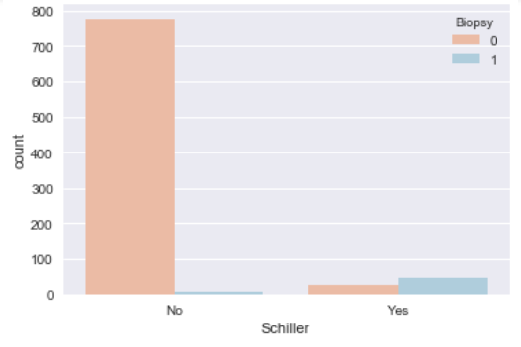
Most of patients with positive Shiller and Hinselmann test results have positive biopsy test.

Slide 7
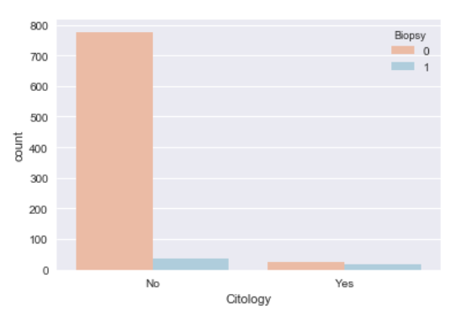
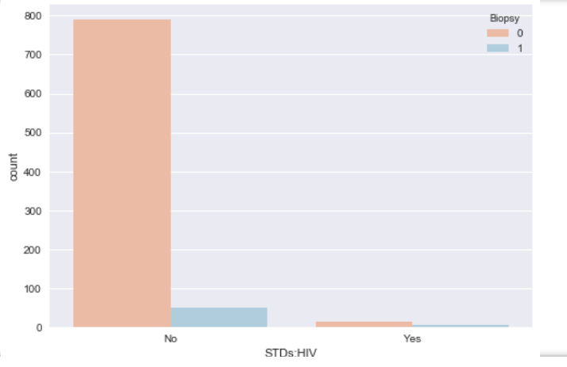
Many of cytology and HIV positive patients also have positive biopsy results.

Slide 8
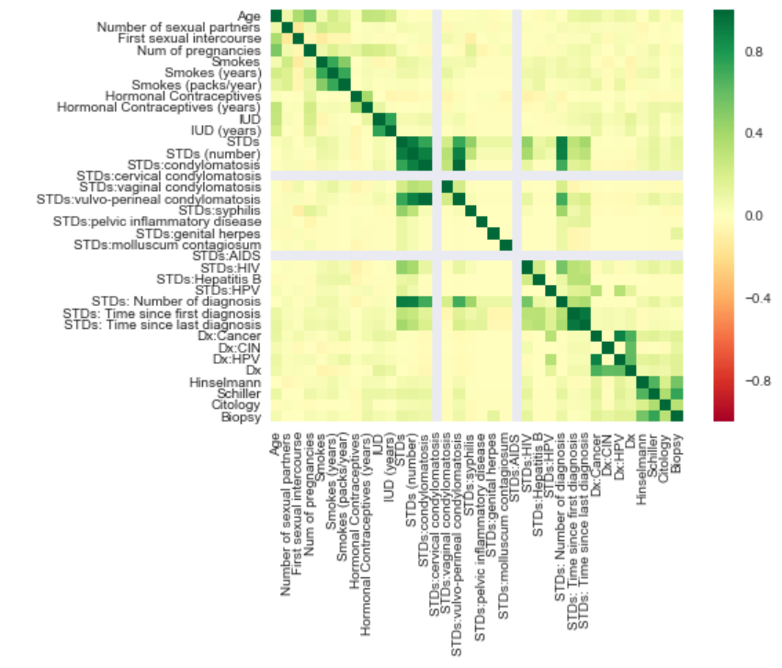
The following plot demonstrates correlations between different features - dark green spots show the most correlated.

Slide 9
Analysis:
KNeighbors, Decision Tree, Random Forest, SVM, Logistic Regression machine learning models were applied to our data. DecisionTreeClassifier performes the better result in predicting if patient has cancer. From 161 patients without cancer the model predicts 157 correctly, and from 11 who has cancer predicts 9 correctly.

Slide 10
Conclusions and recommendations:
In this project we analyzed patients data for cervical cancer prediction and to find out what features may raise a woman's risk of developing it. According to our findings these 3 features have the strongest impact on cancer predictions: Hinselmann, Schiller and Cytology test results. Factors that may raise a woman's risk of developing cervical cancer: HIV, high number of sexually transmitted diseases, long time use of hormonal contraceptives.
Research continues to look into what factors cause this type of cancer and what women can do to lower their personal risk. There is no proven way to completely prevent this disease, but there may be steps you can take to lower your cancer risk. For future research and analysis one of the most important things is data collection and it’s accuracy.

